Slide 1
Efficient Coordination and Transmission of Data for Cooperative Vehicular Safety Applications
C.L. Robinson, University of Illinois
L. Caminiti, D. Caveney, K. Laberteaux, Toyota Technical Center

Slide 2
Problem
Vehicles running multiple safety applications.
Some of the data element required by each application is overlapped.
How to achieve efficient data exchange between vehicles running multiple safety applications.

Slide 3
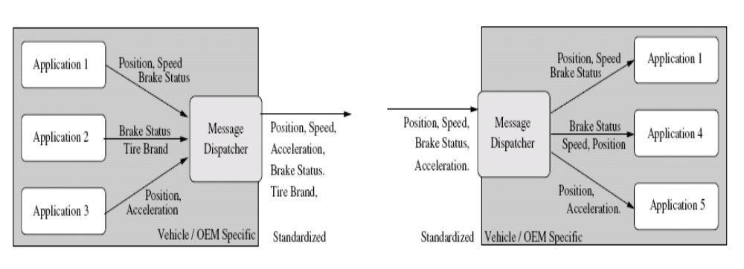
Solution
Message Dispatcher:

Slide 4
Design of the Message Dispatcher
Data Element Dictionary.
Message Construction.
Some example applications are described and some analyses are performed.

